Slide 1
UK XFEL
An exciting opportunity for
science and innovation
xfel.ac.uk
Notes:
1274-WP0-prs-0025-v1.0-UKXFEL Community Slides Extended

Slide 2
The Science Case for UK XFEL 2019-2020
xfel.ac.uk
In the last decade XFELs have had an impressive scientific impact, but there is clearly scope to do much, much more.
Taking a long view we looked at what kind of science we will do with an advanced XFEL operating from mid 2030’s. Extrapolating current technology advances to frame what will be possible.
Science Case Objectives:
To demonstrate scientific need
To define a next generation XFEL capability
To inform the technology that must be developed
Published in 2020 – available online at xfel.ac.uk
xfel.ac.uk
Notes:
1274-WP0-prs-0025-v1.0-UKXFEL Community Slides Extended

Slide 3
Authored by an expert science team
xfel.ac.uk
Matter in extreme conditions: Andy Higginbotham (York), Andy Comley (AWE), Sam Vinko (Ox), Marco Borghesi (QUB), Malcolm McMahon (Edinburgh), Justin Wark (Ox)
Nano/Quantum materials: Anna Regoutz (UCL), Marcus Newton (Soton), Ian Robinson (UCL/Brookhaven), Mark Dean (Brookhaven), Simon Wall (ICFO)
Engineering/Materials/Applications: David Rugg (RR), Sven Schroeder (Leeds), David Dye (IC)
Life sciences: Allen Orville (DLS), Jasper van Thor (IC), Xiaodong Zhang (IC)
Chemical sciences: Julia Weinstein (Sheffield), Russell Minns (Soton), Sofia Diaz-Moreno (DLS), Andrew Burnett (Leeds), Tom Penfold (Newcastle)
Physical sciences: Amelle Zair (KCL), Adam Kirrander (Edinburgh), Jason Greenwood (QUB), Jon Marangos (IC and Science Lead)
*plus around 100 additional experts from around the world contributing to Science Case
Team significantly expanded in 2022 to also include:
Emma McBride (QUB), Awan Shakil (Plymouth), Paolo Raedelli (Oxford), Rebecca Ingle (UCL), Dan Eakins (Oxford), Mark Brouard (Oxford), Claire Vallance (Oxford), Elaine Seddon (Cockcroft), Sarnjeet Dhesi (Diamond), Adrian Mancuso (Diamond)
Notes:
1274-WP0-prs-0025-v1.0-UKXFEL Community Slides Extended

Slide 4
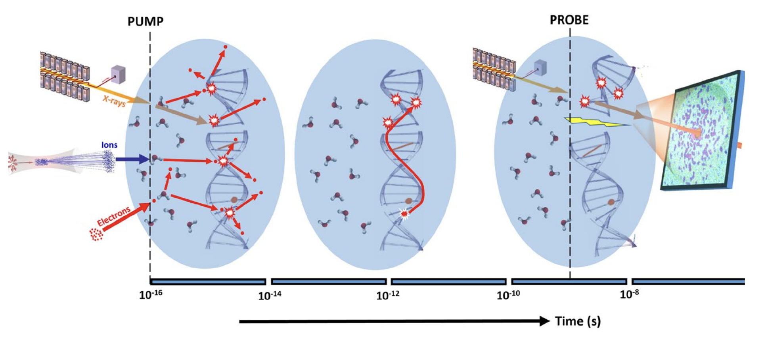
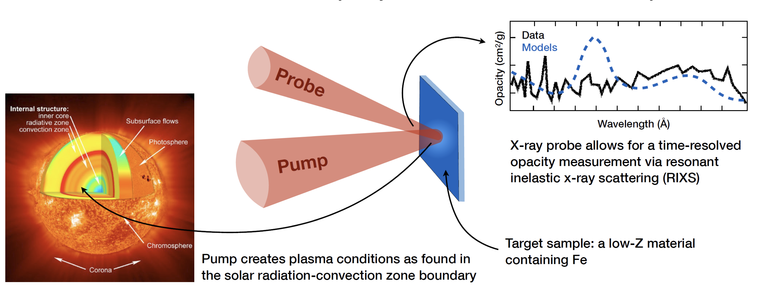
xfel.ac.uk
Ultrafast X-rays to probe attosecond electron dynamics, radiation interaction and damage with materials & biomolecules & elementary processes in chemical reactions
High X-ray intensity and high data rate allow exploration of fundamentals of X-ray matter interaction & new concepts in time resolved imaging at nanoscopic scale of living systems and materials in-operando
Future XFEL Science Highlights
High energy/power optical lasers combined with bright X-rays access the conditions inside planets, stars and shocked materials in engineering, defence & fusion energy technologies
Notes:
1274-WP0-prs-0025-v1.0-UKXFEL Community Slides Extended

Slide 5
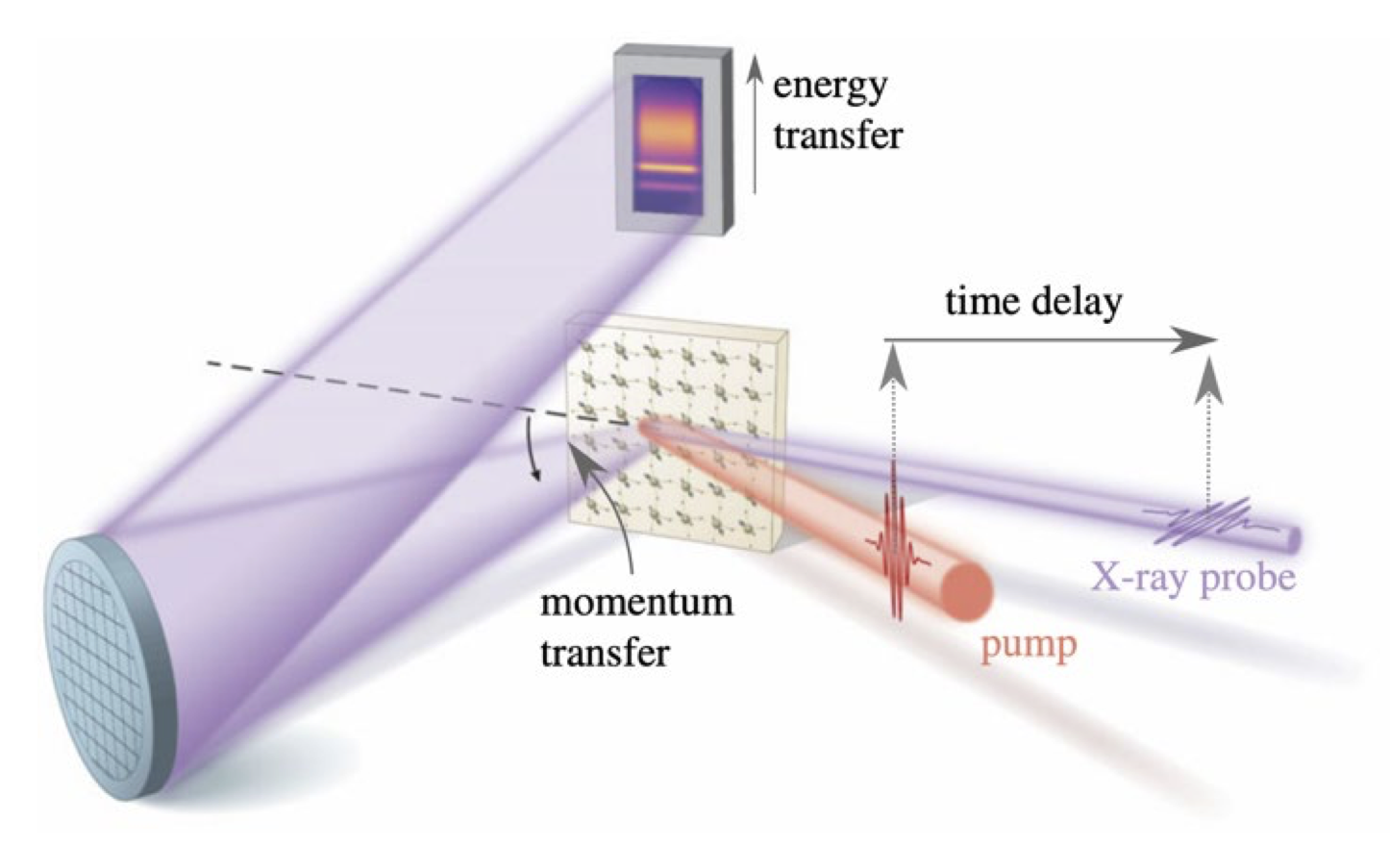
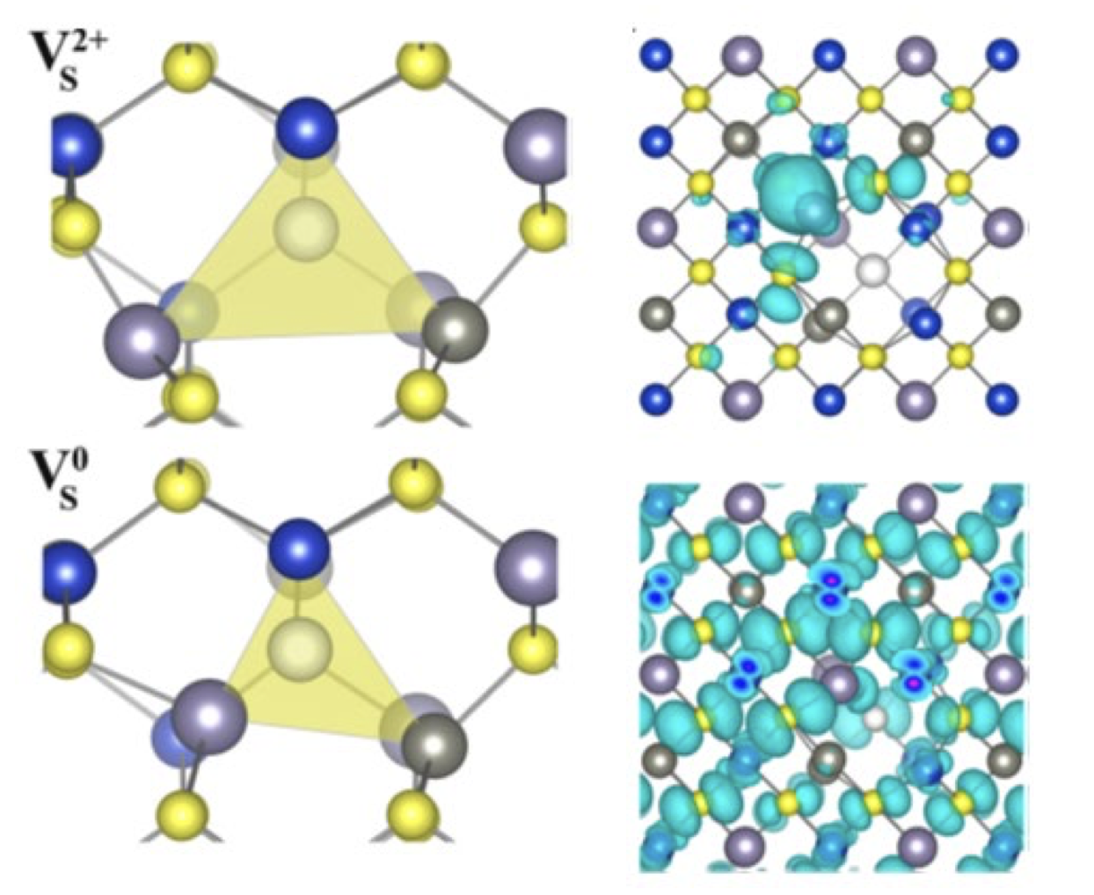
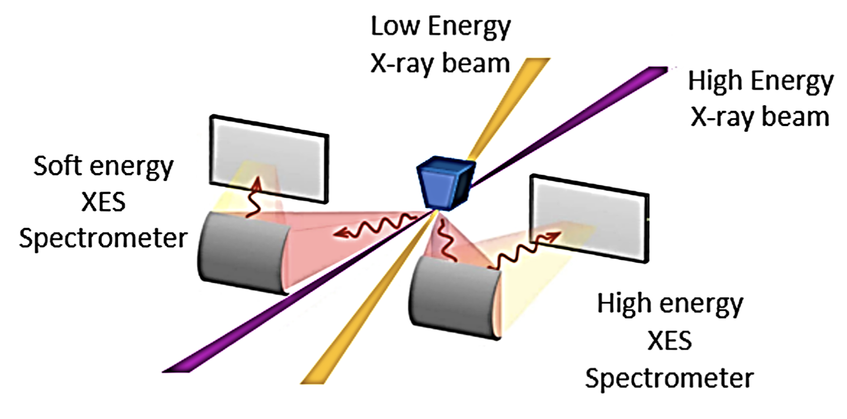
xfel.ac.uk
Transform limited X-rays and high data rates
enable probing and optimisation of photochemical technologies, quantum materials, ultrafast magnetisation, photodetectors & nanotechnologies
X-rays synchronized to ultrafast lasers, THz and electrons
uncover the fundamentals of chemical dynamics in the environment, space, engineering & energy materials
Future XFEL Science Highlights
High rep-rate multi-colour ultrafast X-rays provide powerful approaches to systematic advances in e.g. catalysis, MEC, biochemistry & structural materials
Notes:
1274-WP0-prs-0025-v1.0-UKXFEL Community Slides Extended

Slide 6
UK XFEL
An exciting opportunity for science and innovation
xfel.ac.uk
Key next-generation capabilities identified in the UK XFEL Science Case:
- Transform limited operation across entire X-ray range
- High efficiency facility, with a step-change in the simultaneous operation of multiple end stations
- Evenly spaced, high-rep rate pulses to match samples & detectors
- Improved synchronisation/timing data with external lasers to < 1 fs
- Widely separated multiple colour X-rays to least one end-station
- Full array of synchronised sources: XUV-THz, e-beams, high power & high energy lasers at high rep-rate
UK XFEL Science Case available at xfel.ac.uk
Notes:
1274-WP0-prs-0025-v1.0-UKXFEL Community Slides Extended

Slide 7
UK XFEL
A next generation XFEL
xfel.ac.uk
By October 2025 we will have:
mapped out how best to deliver advanced XFEL capabilities identified in the Science Case
explored a Conceptual Design for a unique new machine that can fulfil all required capabilities
examined other investment options and collaborations in existing XFELs
updated the Science Case to feed into the process and inform future decisions
held multiple Townhall Meetings around UK engaging with the user community
investigated the socioeconomic impact of a next generation XFEL
Project Sponsor :
Science Lead :
Technical Lead :
Project Manager :
John Collier
Jon Marangos
Jim Clarke
Paul Aden
Notes:
1274-WP0-prs-0025-v1.0-UKXFEL Community Slides Extended

Slide 8
UK XFEL
An exciting opportunity for science and innovation
Contact info:
Project Manager - paul.aden@stfc.ac.uk
xfel.ac.uk
Notes:
1274-WP0-prs-0025-v1.0-UKXFEL Community Slides Extended

